Slide 1
Actus Veritas Geoscience, LLC. Integrated Geoscience & Engineering Consulting Solutions Value Creation | Collaboration | Innovation | Quality
A Collaborative, Multidisciplinary Team of Highly Experienced Geoscientists and Engineers Specializing in the Delivery of Integrated Technical and Economic Evaluations of Petroleum Opportunities
info@actusveritas.com
www.actusveritas.com

Slide 2
Delivering Multidisciplinary, Integrated Products through Collaboration & Teamwork
Deep Experience & Commitment to Excellence
AVGeo Team Members have 20 - 35 years of Exploration, Production & Development experience with Major, Large Independent and National Oil Companies.
As individual contributors, team and project leaders we have delivered major projects and saved our companies millions of dollars by initiating efficiencies, streamlining processes, innovating and improving geotechnical processes
We have active experience in the Deepwater & Shelf US & Mexican GOM, W & N Africa, the Caribbean region, South America, Russia, Onshore US & Western Canada, Offshore Newfoundland, Nova Scotia, Labrador and the Canadian Arctic
We have authored papers, talks and posters at professional society meetings, led in-house training seminars and mentored less experienced staff
When you hire AVGeo, you hire the expertise of the Whole Team rightsized to your project. We listen to and collaborate with our clients, integrate our skills, experience and industry best practice to deliver a customized product that has maximum impact in a timely manner.

Slide 3
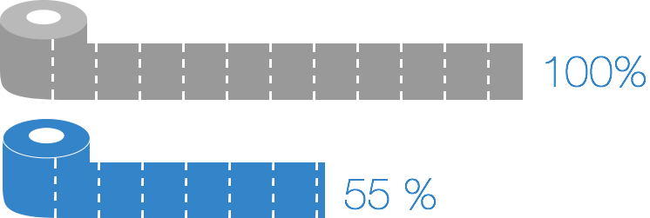
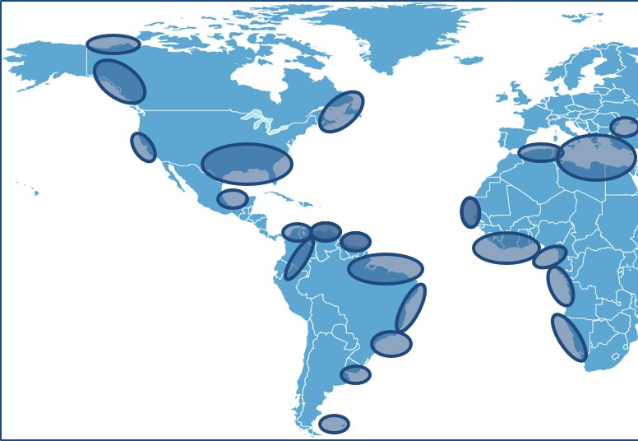
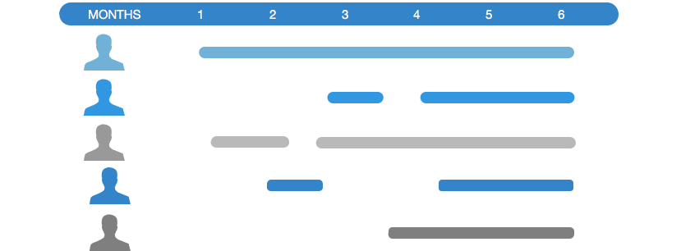
Value Proposition – Save Time and Money Deploying Our Team of Experts
You
AVGeo
Project Staffing Fit for Purpose
Regional Experience
Team / Skills
Integrated
Approach

Slide 4
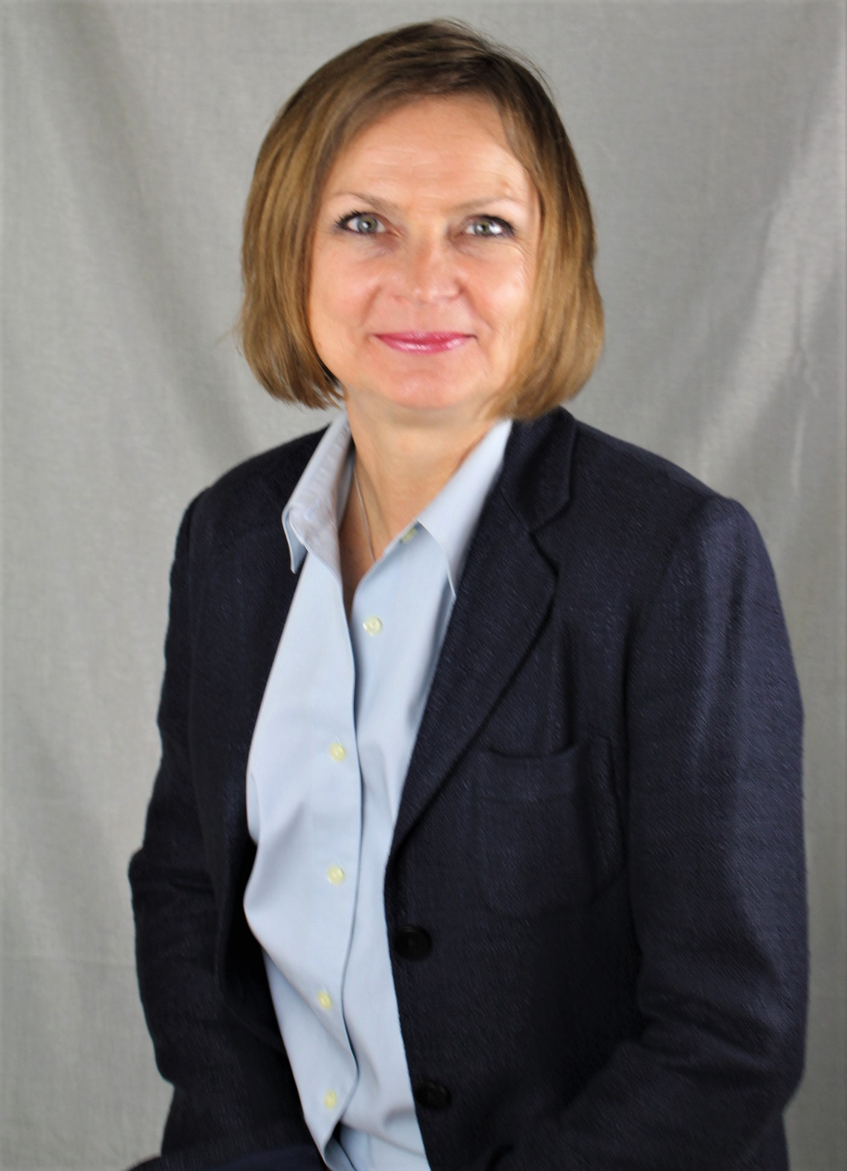
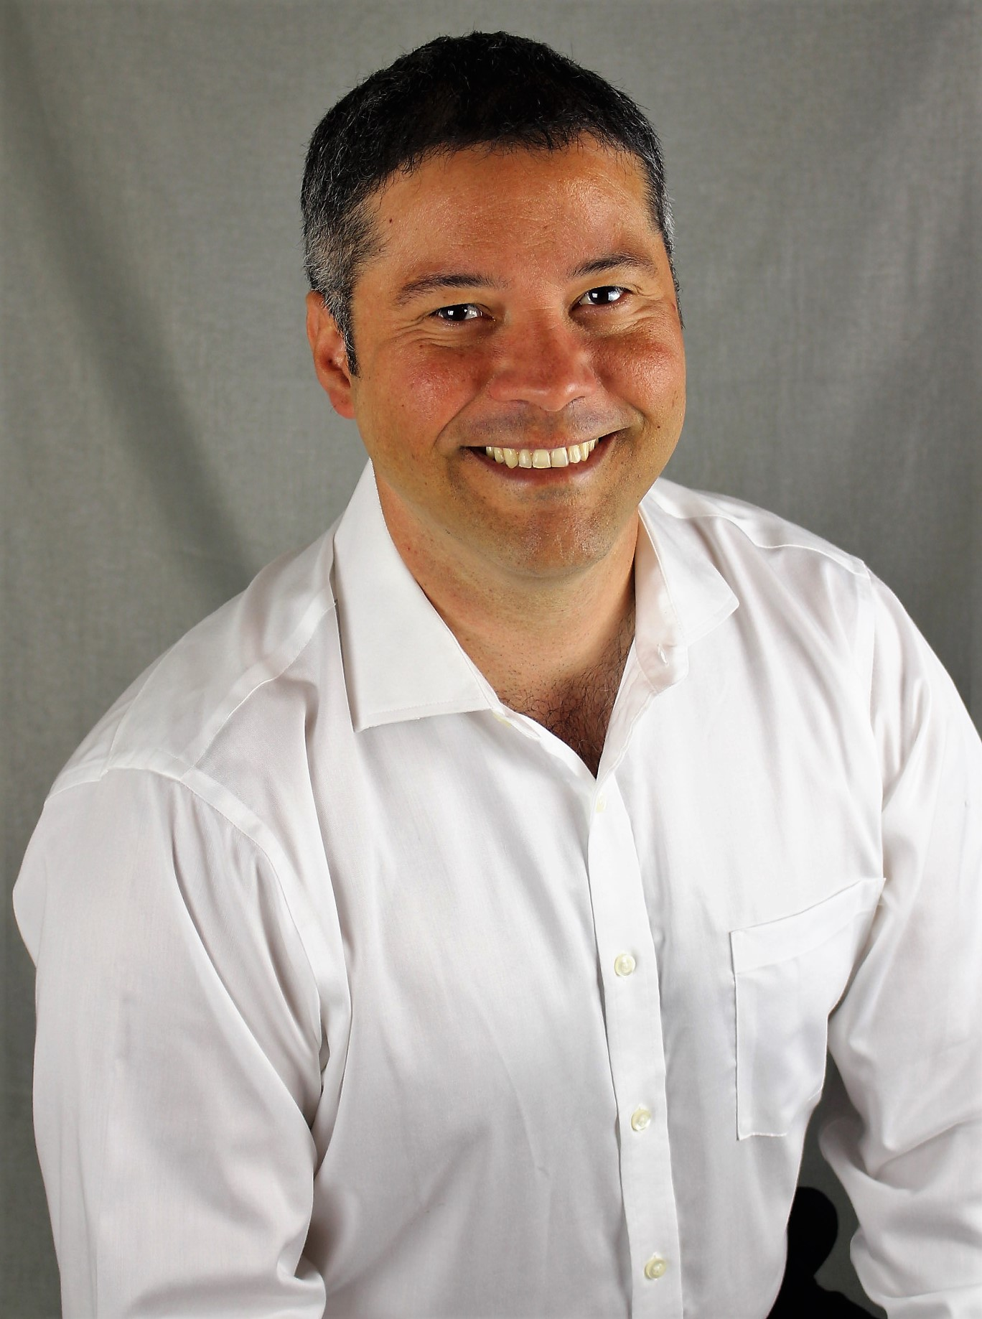
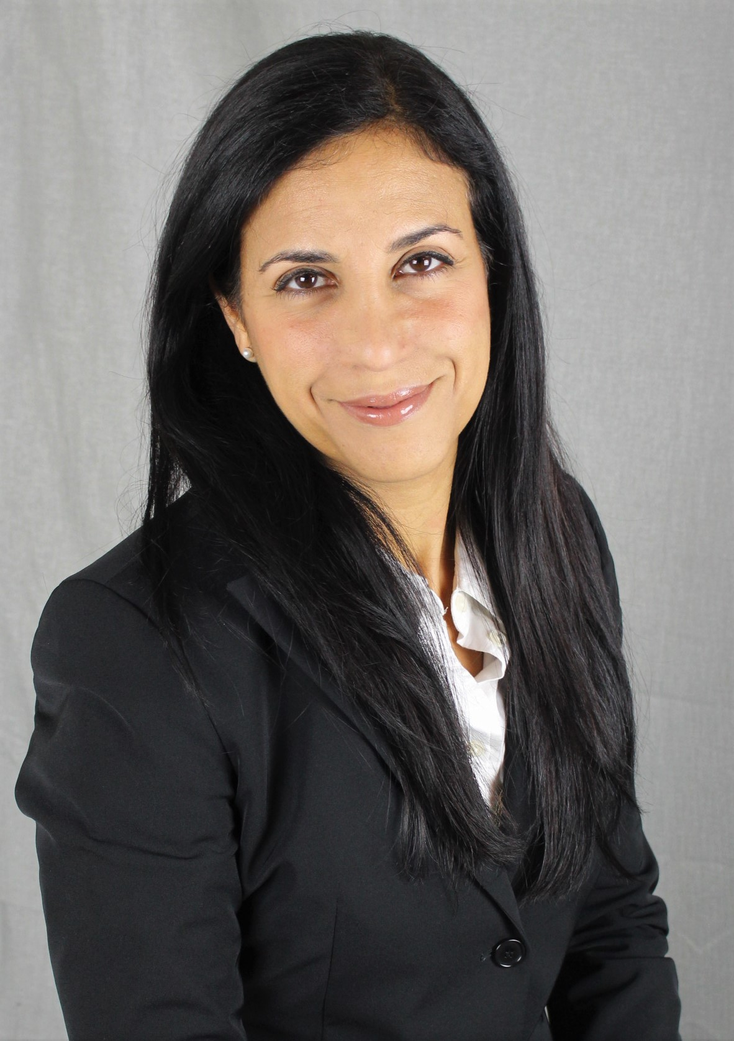
Owners – Managing Directors
Katya Casey
Geosciences
Daniel Mendez
Engineering
Marel Sanchez
Geophysics
25+ years of experience regional/sub-regional evaluations focusing on basin definition, play fairway analysis, play concepts, block value assessments
katya.casey@actusveritas.com
20+ years experience in production operations, business planning, reservoir management and reserves valuation.
Daniel.l.mendez@actusveritas.com
20+ years of experience in exploration and production, definition of play based opportunities, prospect maturation, risk assessment.
Marel.sanchez@actuesvertas.com

Slide 5
Actus Veritas Geoscience Geoscience Skills and Specialties
2D/3D Seismic Interpretation:
In compressional & extensional tectonic regimes and salt provinces.
Facies Analysis
Seismic stratigraphy
Incorporation of QI, AI, AVO, and other seismic analyses
Velocity model improvement and image enhancement
Lead, design and deliver creative, custom exploration projects that include:
Regional/Sub-regional assessments with a focus on basin definition, play fairway analysis, and play concepts
Integration of tectonic, structural, depositional & petroleum systems models to identify/evaluate leads, mature prospects, high-grade inventories, support bid rounds, lease acquisitions and evaluate farm-in/farm-out opportunities
Creation of risked and ranked lead/prospect inventories with full-cycle economic analysis.
Creation of gross depositional environment maps from seismic, well and other geologic data
Critical risk analysis:
Identification of critical risks associated with the project
Customized work plan designed to address and quantify key risks
Creation of Common Risk Segment (CRS) maps
Core analysis, sedimentological interpretation and integrated reservoir characterization
Lead, plan and execute exploration and development drilling programs including:
Well planning,
Casing design input,
Completion recommendations,
Design geochemical, geologic and geophysical data sampling programs
Monitor daily drilling activities.
Basin modeling

Slide 6
Actus Veritas Geoscience Engineering Skills and Specialties
Development of innovative solutions through multi-disciplinary collaboration and application of new technologies to add reserves and enhance value.
Generation of infill drilling, artificial lift, stimulation and workover programs
Inclusion of complex wellbore flow models in reservoir simulator to evaluate alternative completion strategies .
Early model validation through cost effective acquisition reservoir data.
Reservoir surveillance plans and fit-for-purpose models to extend field plateau and maximize facilities utilization.
Robust economic modeling expertise of full-life E&P opportunities
Probabilistic risk and decision tree analysis.
Traditional DCF analysis.
Build economic models for international fiscal regimes (PSA, Service Contracts, etc).

Slide 7
Actus Veritas Geoscience: Academic Research Partners
Dr. Alexei V. Milkov, Professor at Colorado School of Mines
Award-winning scientist specializing in petroleum systems analysis, geochemistry and geologic risk assessment.
University of Houston’s Center for Advanced Analytical Geochemistry
State of the Art Organic, Inorganic, and Isotopic Geochemical Exploration and Petroleum Systems
UTIG Plates Project
Collaboration in research and development of updated Plate Tectonic models and Passive Margin Evolution

Slide 8
Extras

Slide 9
Value Proposition – Save Time and Money Deploying Our Team of Experts
In house NV Team personnel costs to the company assuming mid career geoscientists/engineers (~8 years of experience) with 135 000 $US annual base salary- cost to the company ~250 000 $US with benefits and bonuses. Typical NV management cost to the project ~750$/hr is not modeled. It will take team to work 1 year on project X
250 000 $US
Project Geophysicist
250 000 $US
Project Geologist
250 000 $US
Petrophysicist
250 000 $US
Geoscience Specialist
250 000 $US
Basin Modeler
Actus Veritas costing model using expert level geoscientists/engineers (25+ years of experience) with typical 250 000 $US annual base salary, no benefits, no management overhead to the project, free scoping workshop with key specialists. It will take team to work 3-4 month on project X
Project Lead

Slide 10
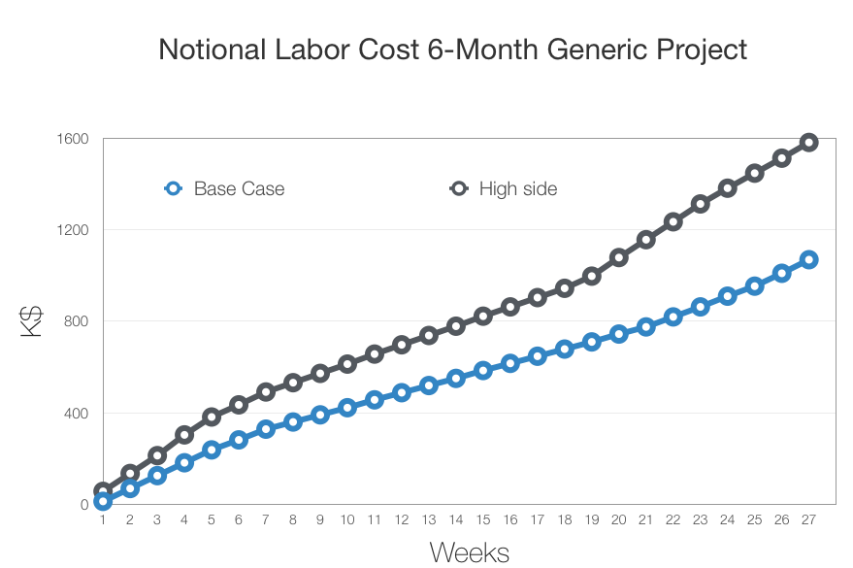
Cumulative Project Cost
Up to six month cumulative Actus Veritas labor cost to the project
Overhead is not included (software licenses, office, IT infrastructure)
One day kick-off workshop is free with travel expenses, if required, billed to the project
Base Case
High Case
High Case

